Slide 1
Lariat Auto Rentals Productivity Solution
Raymond Nanna
10/6/2020

Slide 2





Executive Summary
Objective Increase profit Reduce cost
Plan Develop strategies Compare strategies Combine strategies
Reduce rental price to attract renters that increased profit by 9% and eliminated 10 worst revenue generating car-models reduced cost by $89,545.

Slide 3
Strategy selection.
Building a model Total Revenue Total cost Total profit Total % profit
Develop strategies Strategy 1. Reduce rental price of some cars. Strategy 2. Eliminating 5 worst state location. Strategy 3. Eliminating 10 worst car model. Strategy 4. Consolidate strategy 1 and 3.

Slide 4
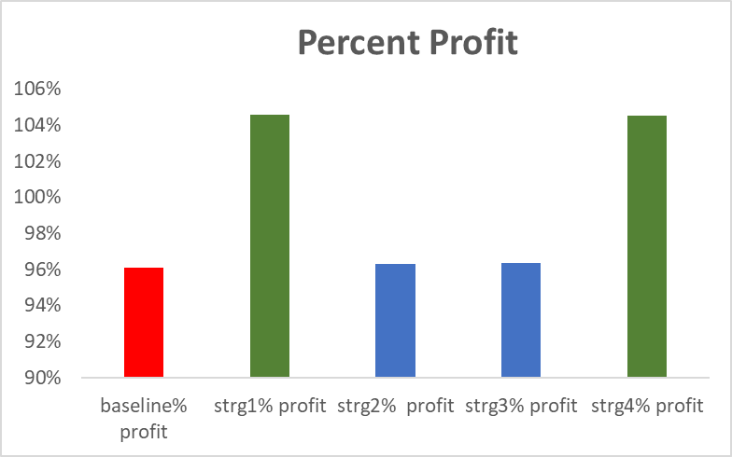
Analysis
Pre strategy analysis:
A total profit of $31,789,351(96%)
A total running cost of $33,076,688
4 of the 878 car-brand runs at a loss
4940 accidents which accounts for4.9% of total 100,000 transactions.
Post strategy analysis:
Analyzed revenue, profit, cost, and profit in percent of all strategies
Compare percent profit, and cost of all strategies

Slide 5
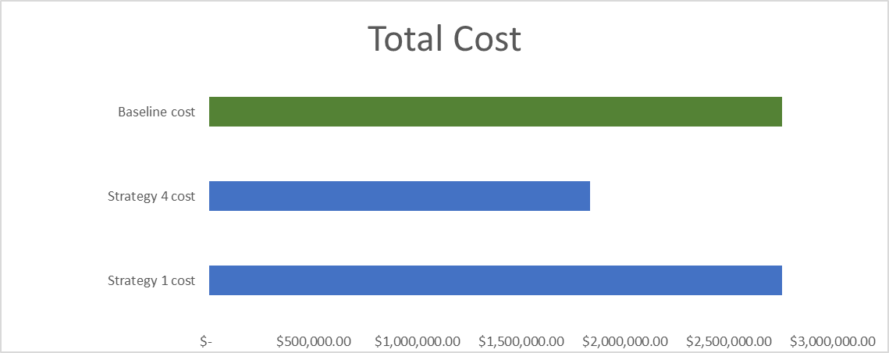
Results
Strategy 1 and 4 both yielded profit of 105% and 105%.
Since strategy 4 yielded a profit of 105% and reduced the total cost by $89,545 I recommend this strategy to grow the auto rentals.

